Slide 2
Presentation Title Placeholder
Date Placeholder: Month, Day, Year
Speaker Name, Job Title

Slide 3
Protect F5 Instance

Slide 4
K13400 – SSL3.0/TLS1.0 BEAST
CVE-2011-3389The SSL protocol, as used in certain configurations in Microsoft Windows and Microsoft Internet Explorer, Mozilla Firefox, Google Chrome, Opera, and other products, encrypts data by using CBC mode with chained initialization vectors, which allows man-in-the-middle attackers to obtain plaintext HTTP headers by way of a blockwise chosen-boundary attack (BCBA) on an HTTPS session, in conjunction with JavaScript code that uses (1) the HTML5 WebSocket API, (2) the Java URLConnection API, or (3) the Silverlight WebClient API, also known as a BEAST attack.
CVE-2012-1870Additionally, the CBC mode in the TLS protocol, as used in Microsoft Windows XP SP2 and SP3, Windows Server 2003 SP2, Windows Vista SP2, Windows Server 2008 SP2, R2, and R2 SP1, Windows 7 Gold and SP1, and other products, allows remote web servers to obtain plaintext data by triggering multiple requests to a third-party HTTPS server and sniffing the network during the resulting HTTPS session, also known as TLS Protocol Vulnerability.

Slide 5
SSL Protections

Slide 6
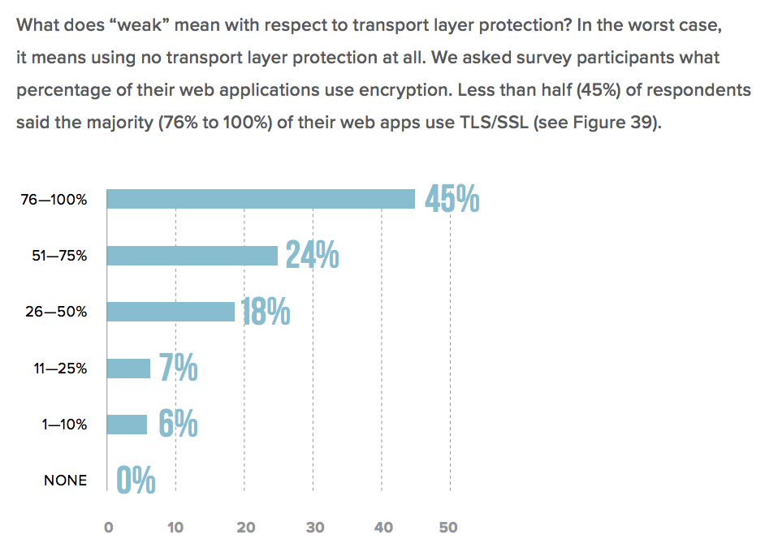
2018 Application Protection Reports https://f5labs.com

Slide 7
Qualys SSL-Labs
SSL Labs scoring:
https://devcentral.f5.com/articles/security-sidebar-improving-your-ssl-labs-test-grade
https://devcentral.f5.com/questions/howto-getting-an-awesome-qualys-ssl-labs-rating-feb-2017-update-51489
!SSLv2:!EXPORT:!DHE+AES-GCM:!DHE+AES:!DHE+3DES:ECDHE+AES-GCM:ECDHE+AES:RSA+AES-GCM:RSA+AES:ECDHE+3DES:RSA+3DES:-MD5:-SSLv3:-RC4

Slide 8


Lab 2
In this lab you will protect your BIG-IP instance and apply SSL protections for your application.
Apply F5 BIG-IP management SSL settings
Create SSL profile rules and groups
Create Hackazon Virtual Server with SSL profiles.

Slide 9
Secure App with WAF policy

Slide 10


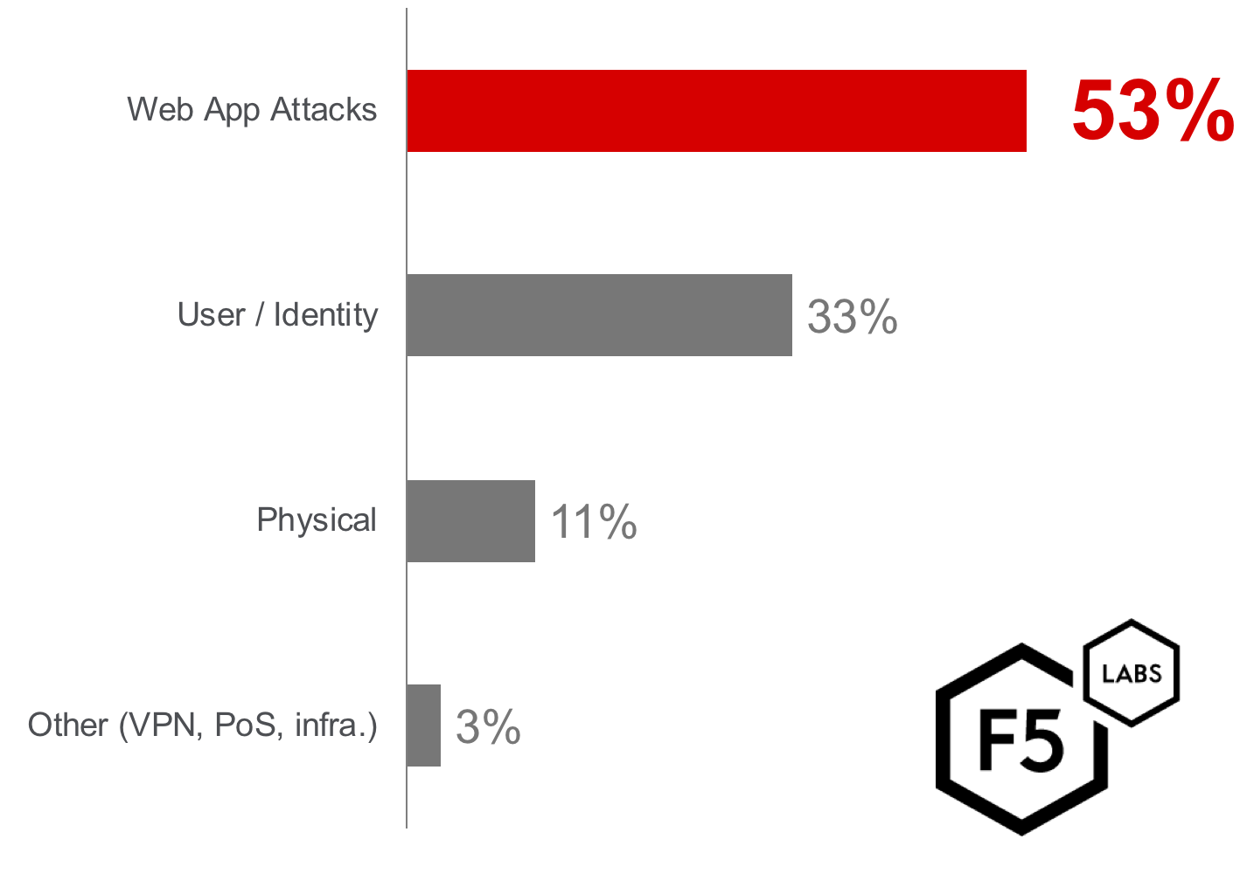
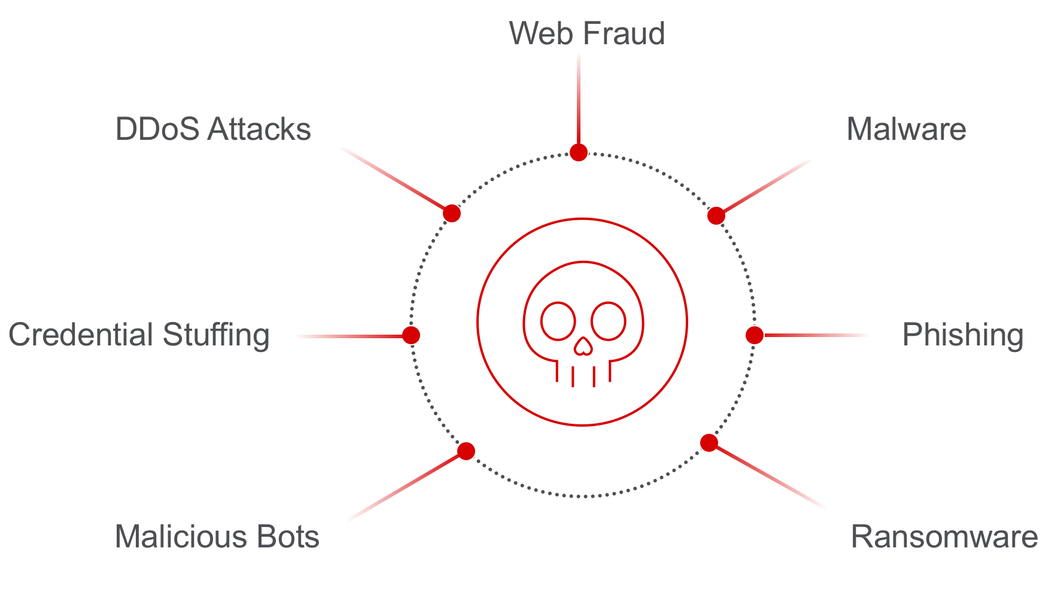
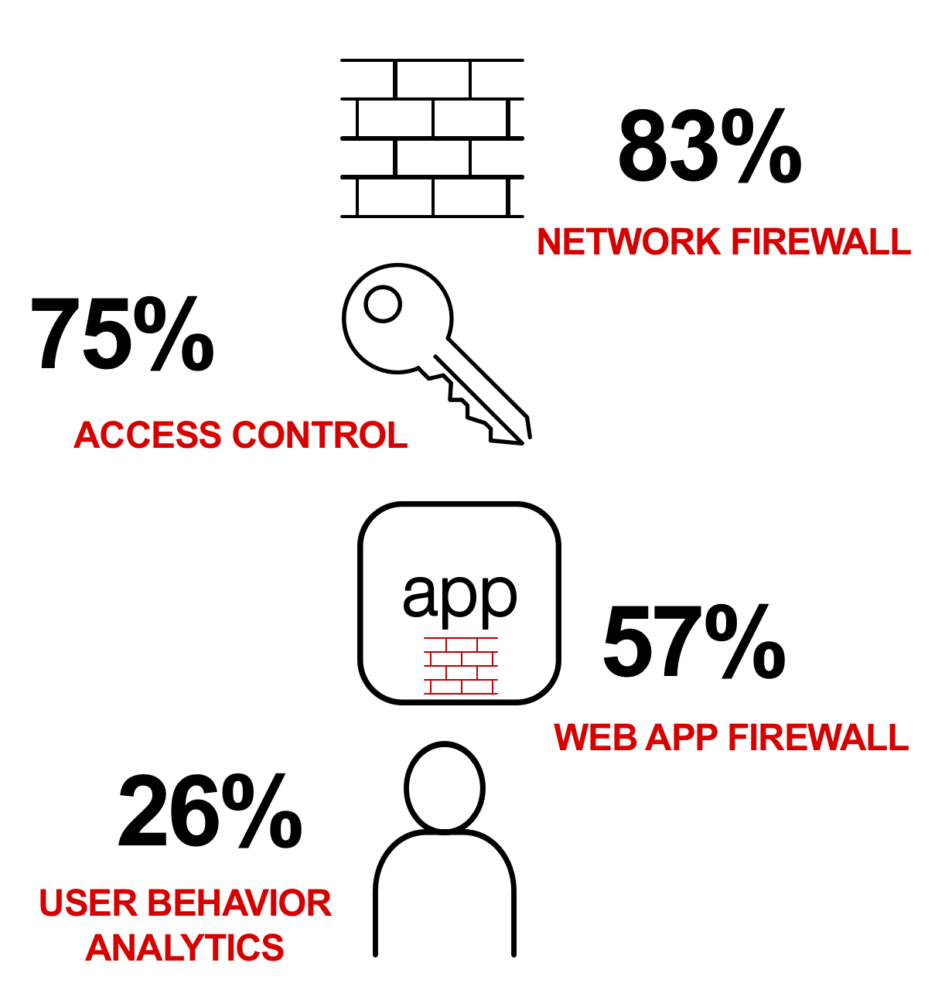
Threat Intelligence Report: Lessons Learned from a Decade of Data Breaches
What are today’s common threats?
What technologies do you use to protect apps?
Web app attacks are the #1 single source entry point of successful data breaches…
Which technology is best suited to mitigate these threats?

Slide 11

F5 Advanced Web Application Firewall
Traditional WAF
Advanced WAF
OWASP Top 10
Proactive Bot Defense
Behavioral DoS Defense
Regulatory Compliance
Credential Protection
Client-side Integrity Defense
Mobile
Blacklisting
Mobile App Security
API Security
Notes:
Important to note though is that not all WAF technology is created equal. We kind of see traditional WAFs as having these base capabilities (which even then not all services claiming to be WAF have). While advanced WAF allows for all of that and more active and intelligent traffic and risk management.
11
© 2018 F5 Networks

Slide 12

Advanced Web Application Firewall
Defend against bots
Proactive bot defense
Anti-bot mobile SDK
Client and server monitoring
Anti-bot Mobile SDK
F5 Advanced WAF
Users
credentials
Bot Mitigation
Credential Protection
App-Layer DoS
Mobile
Prevent Account Takeover
App-level encryption
Mobile app tampering
Brute Force protection
Hacker
Bots
Defense beyond NGFW and simple WAF
52%
96%
72%
Protect apps from DoS
Auto-tuning
Behavioral analytics
Dynamic signatures
of Internet traffic is automated
of Login Pages scraped by bad BOTs
of attacks target Apps and Identity

Slide 13

Lab 3
In this lab you will apply a WAF policy to protect the hackazon app.
Create WAF logging profile
Create WAF Parent policy
Create base WAF Child policy
Create credential protection WAF Child policy
Update Parent WAF policy

Slide 14
Automating app Security services

Slide 15

Enable Application Agility and CI/CD
Migration without downtime: Create policy to control migration and gain performance visibility
Dedicated App Services: Eliminate the challenges of multi-tenant platforms
Web Application Firewall (WAF) for every App: Reduce security risk for every app
Enable Self Service: Provide frictionless app services while enforcing security controls
Scale On Demand: Bring cloud-like autoscale capabilities on prem
Data Center
Private Cloud
BIG-IQ License Manager
Service
Catalog
Azure
NetOps
DevOps
Application
Owner(s)

Slide 16
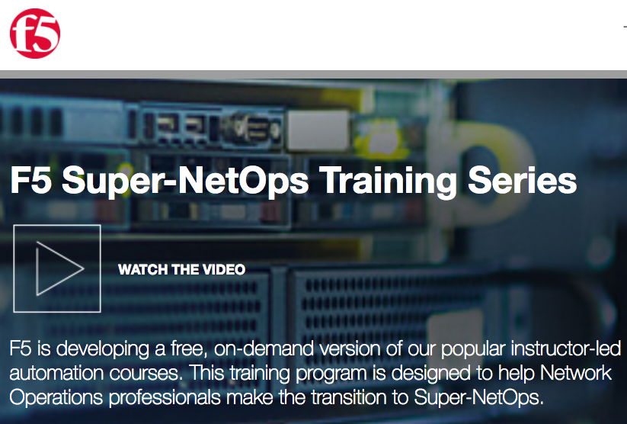

Skills Transformation Enabling NetOps to participate in DevOps
Super-NetOps
DevOps Concepts
Infrastructure as Code
Automation Toolchains
NetOps
Super NetOps
DevOps
Enablement
TRANSFORMATION

Slide 17
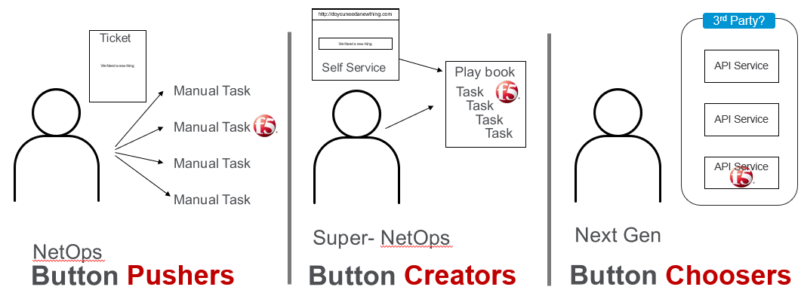

Our Evolving Customers
We Need a new thing
Play book
http://doyouneedanewthing.com
3rd Party?
Ticket
Task
We Need a new thing
Self Service
Task
API Service
Task
Manual Task
Task
Manual Task
API Service
Manual Task
API Service
Manual Task
Super- NetOps
Next Gen
NetOps
Super-NetOps
NetSecDevOps
NetOps
Button Pushers
Button Creators
Button Choosers
Manual Processes
Bottleneck – Human Speed
Inconsistent services
Increase risk
Create Automation playbooks
Frictionless BIG-IP services
Consistent services
Minimize risk
Select Services
Build Integrations
More ‘what’ than ‘how’ plus the ability to enable consumption

Slide 18
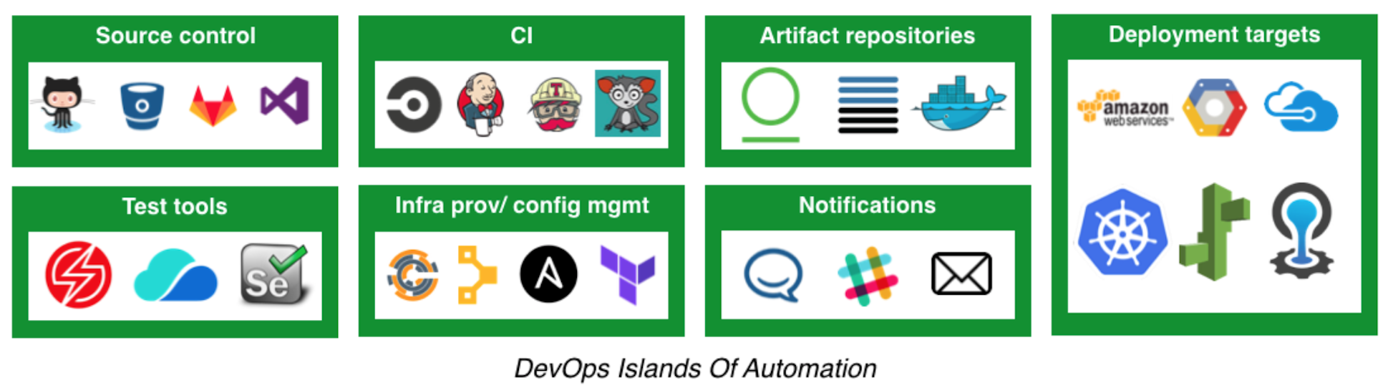
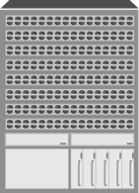




Which tool should I use?
Hypervisor

Slide 19
F5 BIG-IP + Ansible
Ansible is a leading IT automation tool of choice
Current Stable release is version 2.5
BIG-IP 12.x and above
BIG-IP Platform
HTTPS
SSH
Server
Ansible Modules:
F5 – 65 ( 96 in v2.6)
PAN – 24
Cisco Routes/Switches – 97
Cisco ACI – 51
“source of truth”
Idempotency
HTTPS
BIG-IP Platform
FACTS
https://github.com/F5Networks/f5-Ansible
http://clouddocs.f5.com/products/orchestration/ansible/devel/

Slide 20
BIG-IP Administrative work in minutes
ONBOARDING
App Services
Enable/Disable
DNS
NTP
Provision Modules
Virtual Servers
Pool Members
Nodes
Application Readiness
Application deployment
Create Policies
Run BIG-IP commands
Upload
iRules
iApps

Slide 21
Lab 4
In this lab you will automate app security services to protect the hackazon app.
Deploy Super-NetOps host
Deploy Hackazon App using F5 Declarative AS3 template

Slide 22
Thank You

